Slide 1

Analysis of Efficacy of Drugs that treat Hypothyroidism
Chandrika Bolla
Nidhi Mittal
Kamala Nayana

Slide 2
Contents
Introduction
Problem Statement
Approach
Architecture Diagram
Use Cases
Object Model
Screen Shots

Slide 3
Introduction
World Health Organization (WHO) is a specialized agency of the United Nations that is concerned with international public health. WHO wants to find the best Drug to treat Hypothyroidism by conducting a health study throughout the world. This project concentrates in finding the drug that showed best results on the patients who participated during this health study.

Slide 4
Problem Statement
According to “American Thyroid Association” 1 in every 10 people of the overall population is suffering with hypothyroidism.
There is a need to find an effective drug with appropriate chemical composition that can treat this disease at its best and help in speedy recovery of the patient.

Slide 5
Approach
In this project we are considering world as our ecosystem
World Ecosystem contains array of country Networks
Every network contains Enterprise Directory

Slide 6

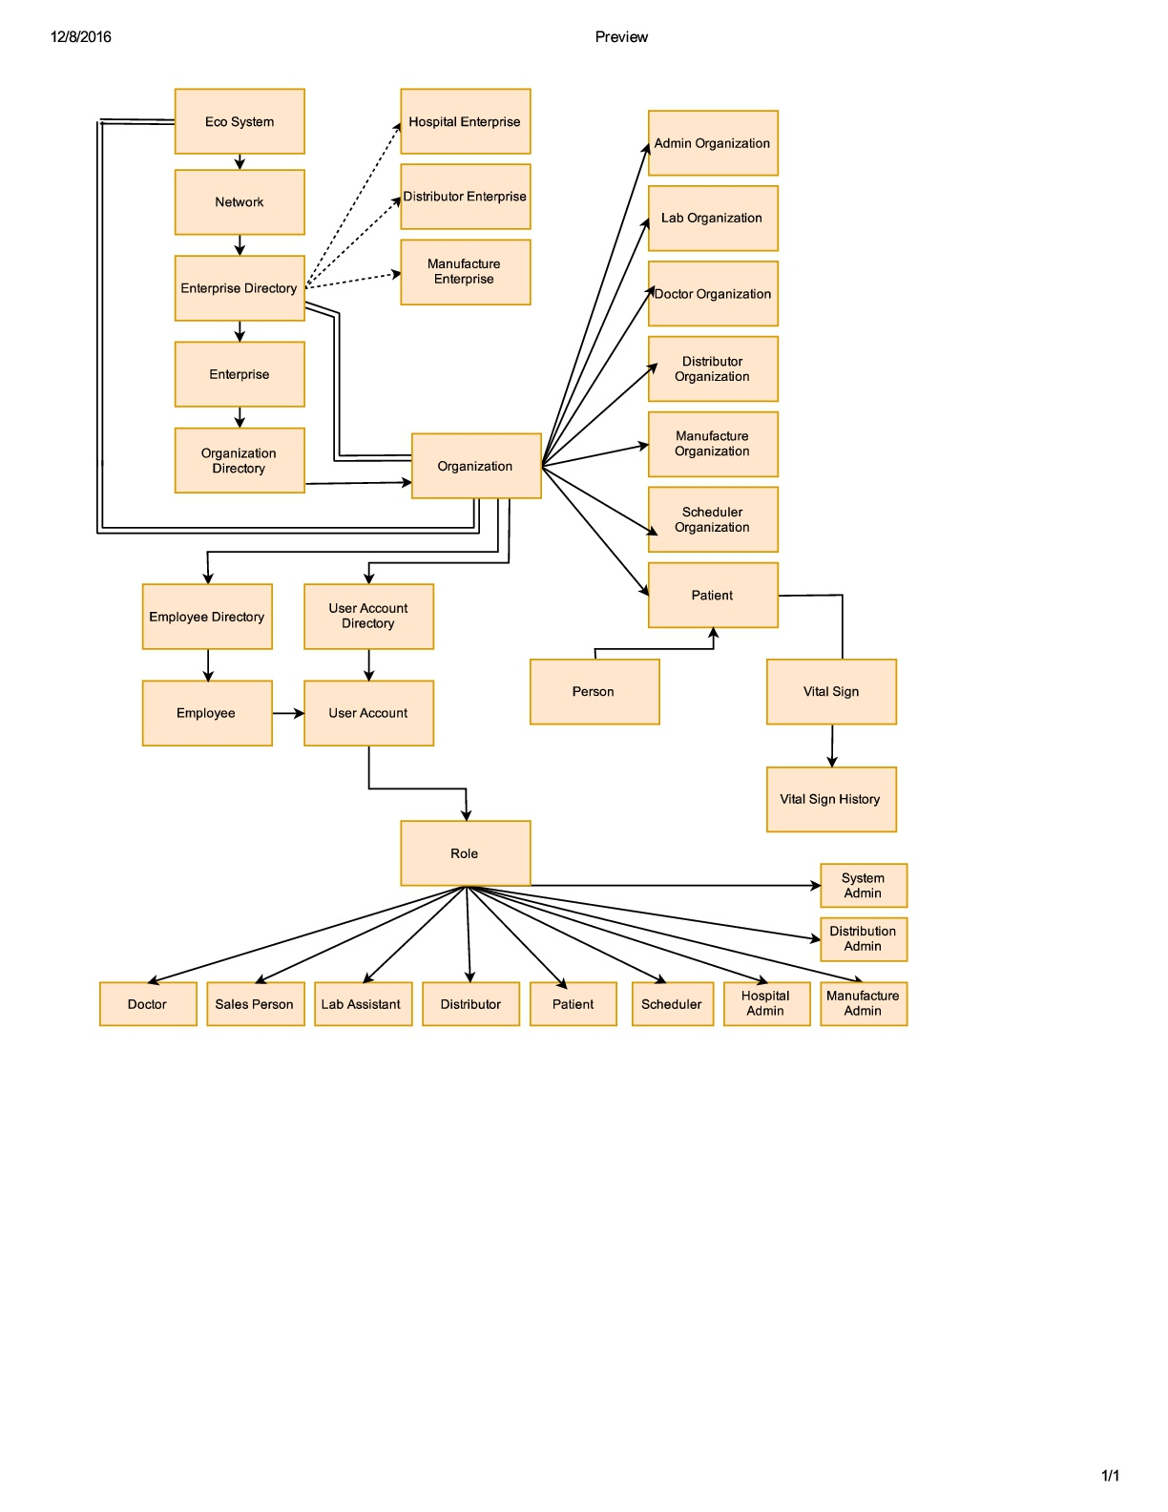
Architecture Diagram

Slide 7
Use Cases
Appointment scheduling between patient and scheduler
Lab test request between scheduler and lab assistant
Order drug request between doctor and distributor
Order drug request between distributor and sales person

Slide 8
Roles
System Admin Role
Patient Role
Doctor Role
Lab Assistant Role
Scheduler Role
Sales Person Role
Distributor Role
Hospital Admin Role
Manufacturer Admin Role
Distributor Admin Role

Slide 9
System Admin Role
System Admin can login to the main system
Can manage all the networks and can add new networks
Can add and manage the enterprises
Can add and manage the enterprise admins

Slide 10
Hospital Admin Role
Manage Employee User Accounts
Can assigning user name and password
Manage Patients
Can view and add new patients
Manage Organization
Can add organizations to the networks
Manage Employee
Can add employees to a particular organization

Slide 11
Manufacturer Admin Role
Manage Employee User Accounts
Can assigning user name and password
Manage Organization
Can add organizations to the networks
Manage Employee
Can add employees to a particular organization
Manage Drugs
Add and view the drug details like dosages, components and their percentages

Slide 12
Distributor Admin Role
Manage Organization
Can add organizations to the networks
Manage Distributor User Account
Can assigning user name and password
Manage Employees
Can add employees to a particular organization
Manage Drugs
Add and view the details and dosages of the drugs list ordered to manufacture

Slide 13
Patient Role
Patient requests scheduler for appointment
View the appointment details like appointment date, doctor and lab assistant names
View his/her health reports which include test result status and date
View his personal details like first name, last name, address, age

Slide 14
Doctor Role
View the test results of patients
View next appointment patient details
Prescribe medicine for patients based on their reports
Lab Assistant Role
Process the test requests from the scheduler
Submit the test result details which include T3, T4, TSH

Slide 15
Scheduler Role
View the patient appointments by date
Add patients to todays appointment list
View and process the patients appointment requests
Requests doctor for appointment

Slide 16
Sales Person Role
Distributor Role
View the list of medicines ordered by doctor and process the work requests
View and list of medicines ordered by distributor and process the work requests

Slide 17
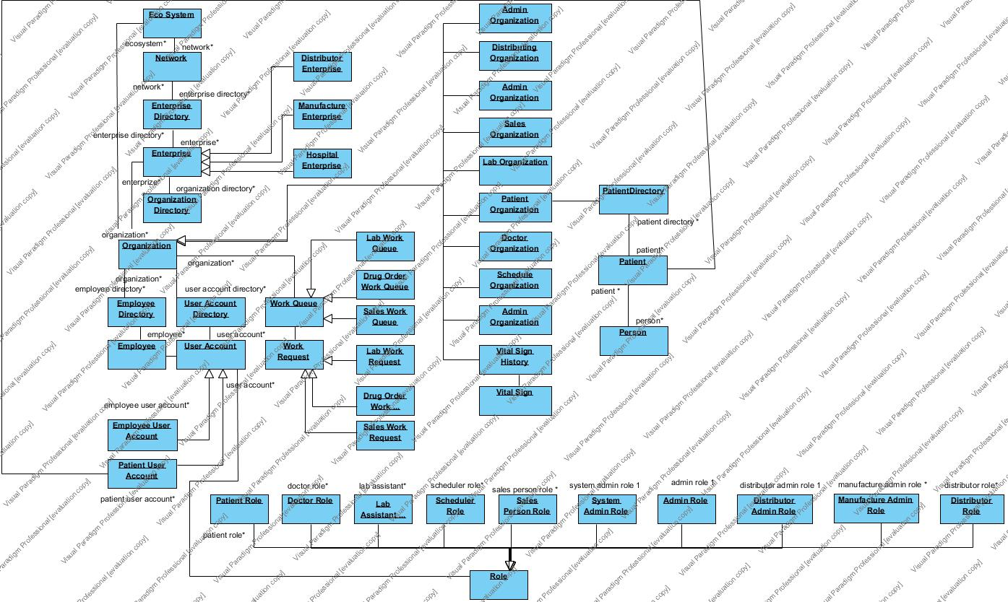
Object Model

Slide 18
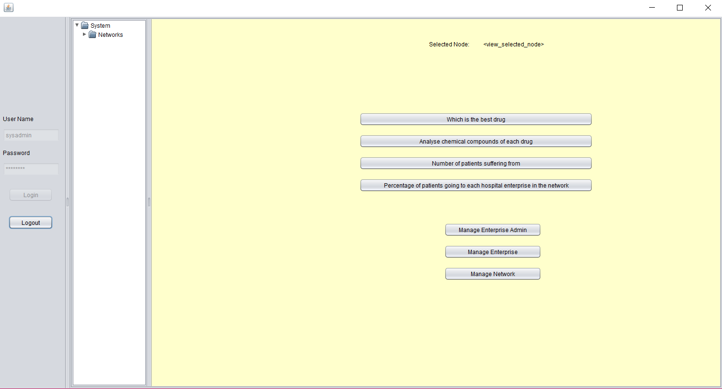
System Admin Login

Slide 19
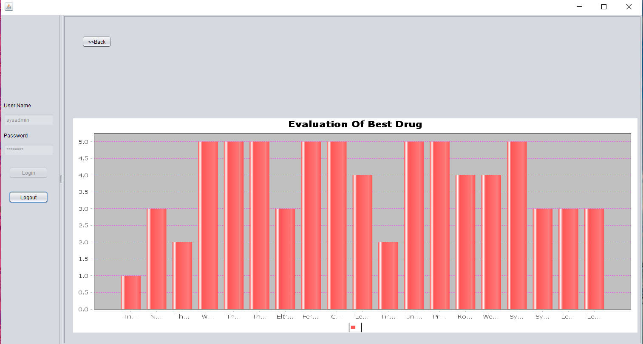
Slide Title

Slide 20
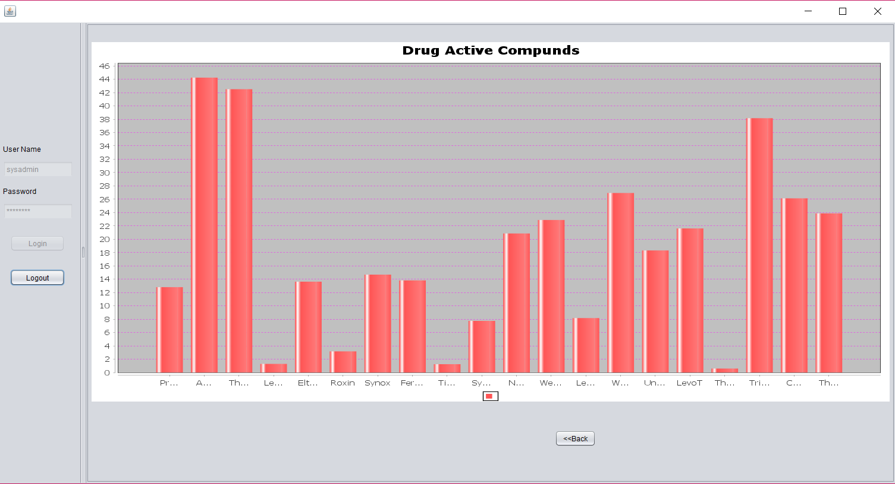
Slide Title

Slide 21
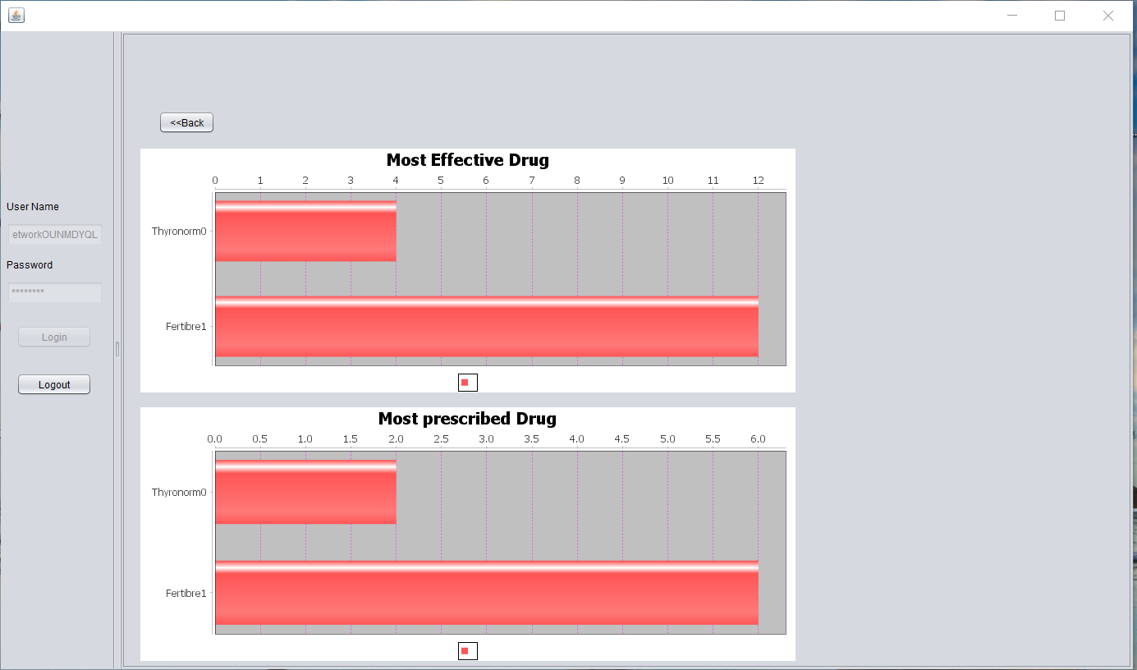
Slide Title

Slide 22
Conclusion
Analysis is done successfully and reports are generated

Slide 23
THANK YOU

